Slide 1
COMP 2406
Callback Hell
(aka Bracket Hell)

Slide 2
COMP 2406
Asynchronous Functions in JavaScript with Node.js

Slide 3
Asynchronous Javascript Functions
It is very typical the Javascript environments (Browsers, Node.js) to provide asynchronous functions.
The node.js execution environment provides many utility functions that are asynchronous (and take a call-back function parameter).
Here we look at the motivation behind them and the style of programming that results which is often referred to as "Callback Hell" (as opposed to "Spaghetti Code").
Callback Hell is characterized by a lot of nesting and brackets. (Use editors that will show you matching brackets.)

Slide 4
Asynchronous Javascript Functions
Asynchronous Callback Functions are characterized by defining functions within other function definitions which results in a lot of nested brackets.
function (… function(){…} ){…}
[It is essential to use an editor the shows matching brackets]

Slide 5
Asynchronous Javascript Functions
Javascript functions use many bracket syntaxes
The following are all very common javascript syntaxes involving functions and brackets
f(){...}
f()
f(){...g(){...}...g()}
f(){...return g(){...}}
f.g()
f(g(){...}){...g()}
(f(){...})()
(f(){...}())
f()()
(f(){}())()
f(){... f=function(){}}

Slide 6
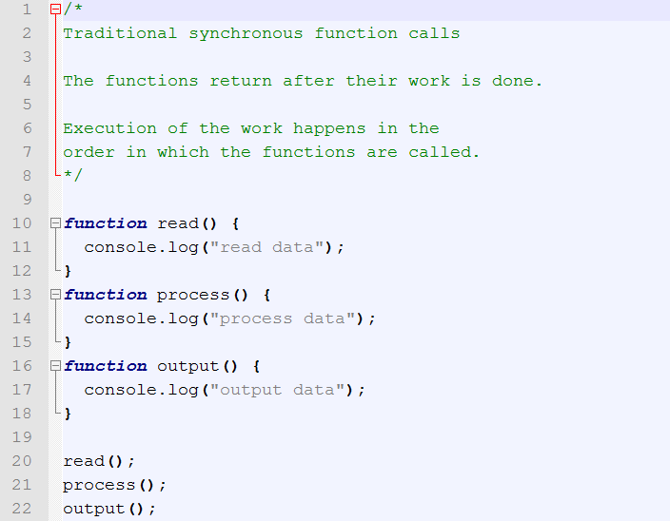
Synchronous Functions
Traditional blocking function calls

Slide 7
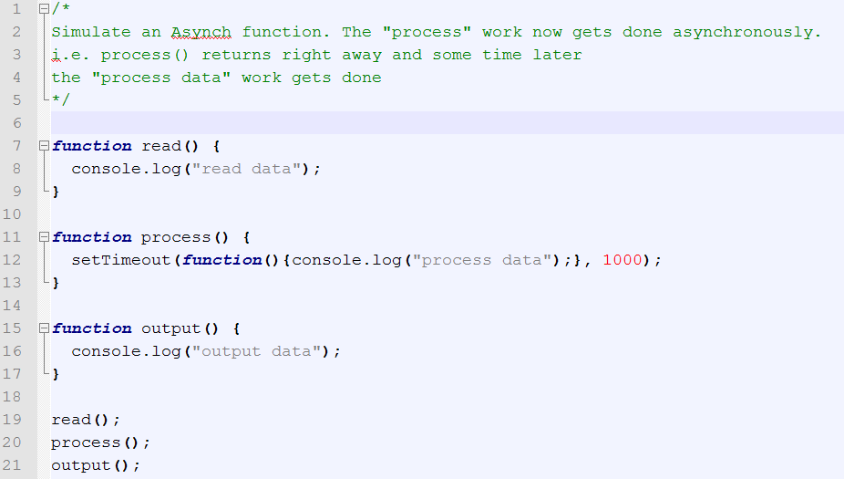
Asynchronous Functions
Asynchronous function

Slide 8
Asynchronous Javascript Functions
The previous examples use asynchronous utility functions (setTimeout) which "condems" the outer function to the effective be asynchronous as well.
Node.js, and browsers achieve asynchronous behavior by putting the function's body on an event queue but the function call return immediately.
FIFO Queue
Process(){…}
Read(){…}
Execution
Return result, but how?

Slide 9
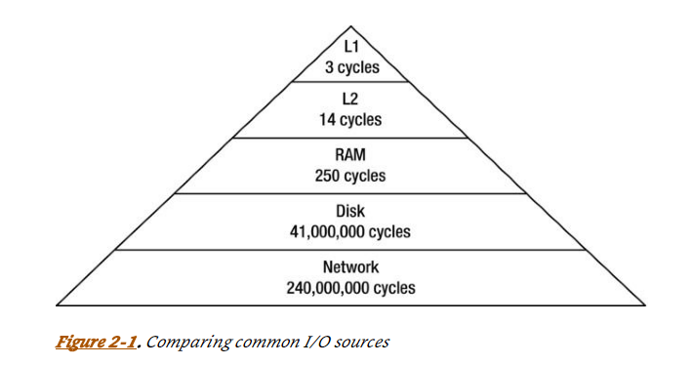

Motivation for Asynchronous Functions
Accessing Data in memory, disk, network.

Slide 10
Motivation for Asynchronous Functions
What do servers and browsers spend most of their time doing?
Node.js provides asynchronous functions for accessing the file system, network requests, streams, timers, and other things.

Slide 11
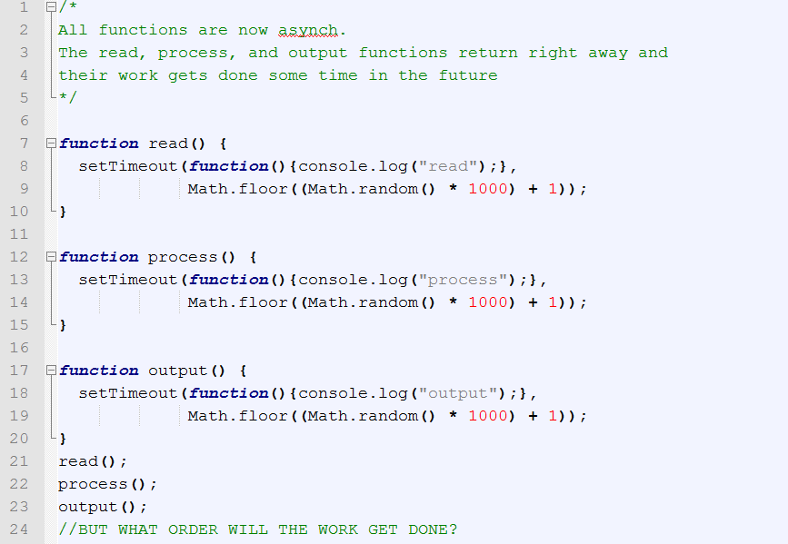
Asynchronous Functions
Order or exectution?

Slide 12
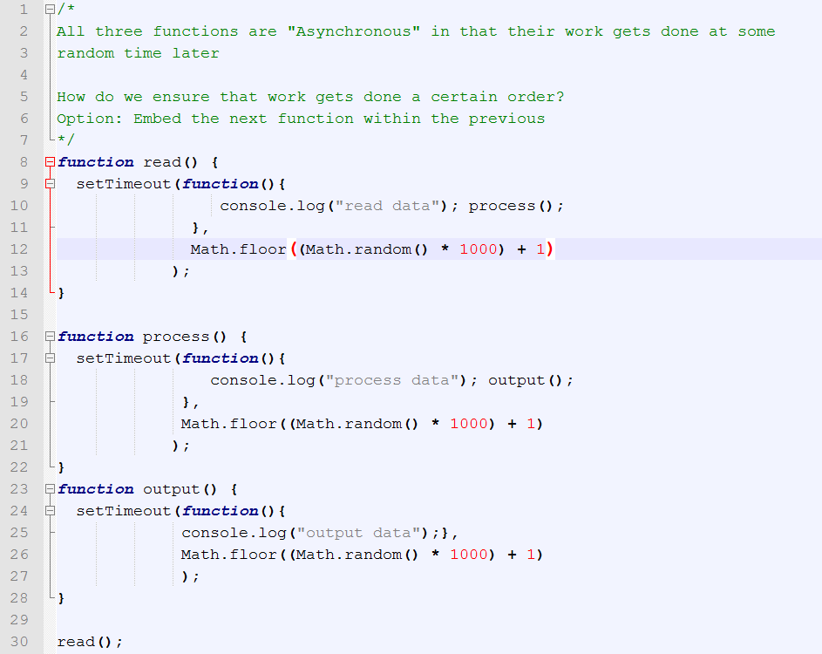
Asynchronous Functions
Order or exectution?

Slide 13
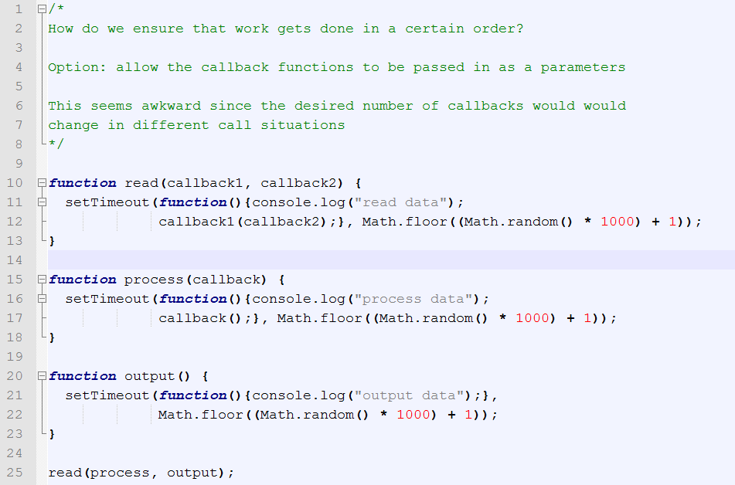
Asynchronous Functions
Parameterized Callbacks

Slide 14
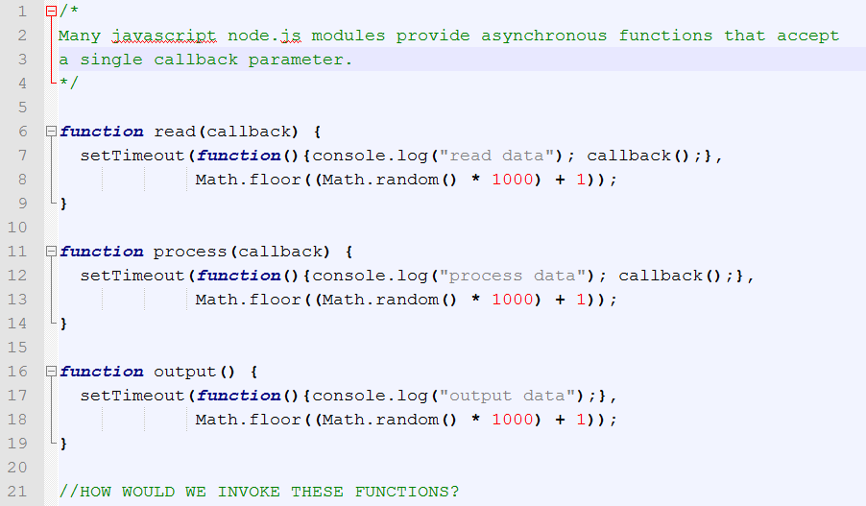
Asynchronous Functions
Single Callback function parameter

Slide 15
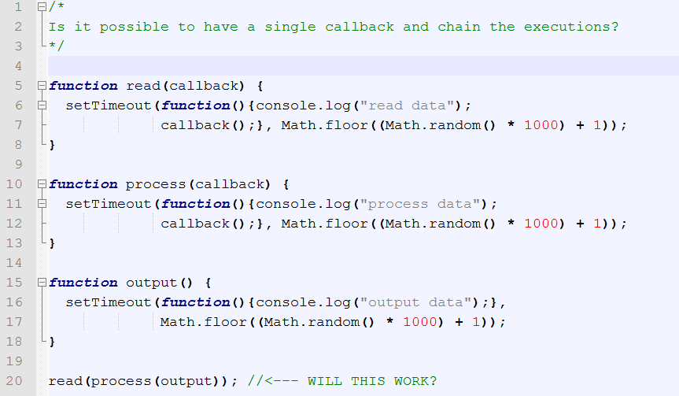
Asynchronous Functions
Single Callback parameter –chaining executions

Slide 16
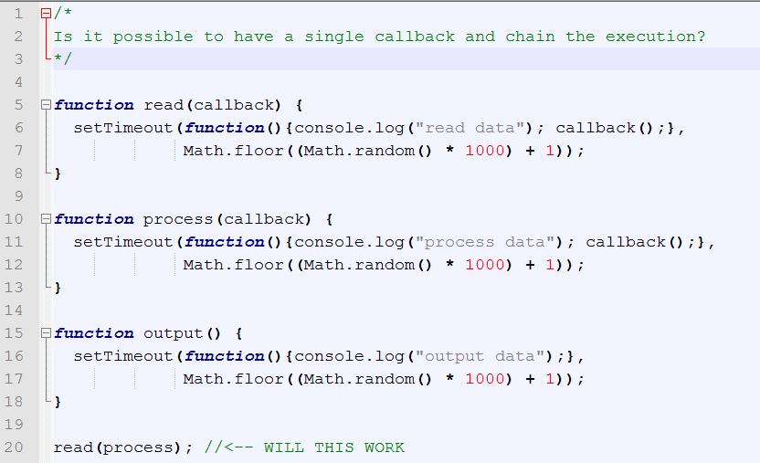
Asynchronous Functions
Single Callback parameter –chaining executions

Slide 17
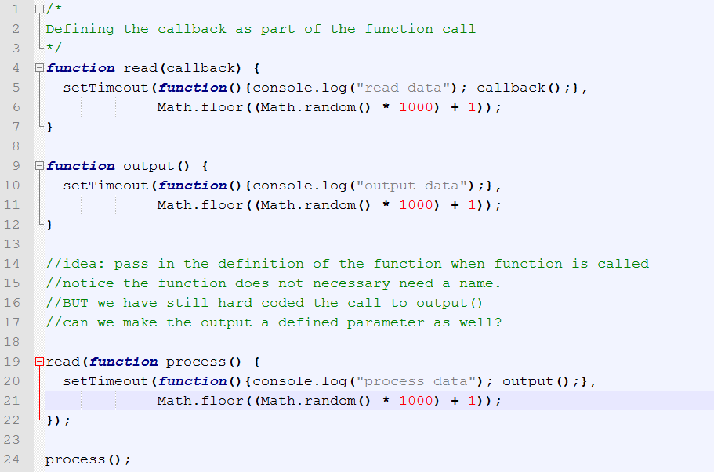
Asynchronous Functions
Passing function definition as callback

Slide 18
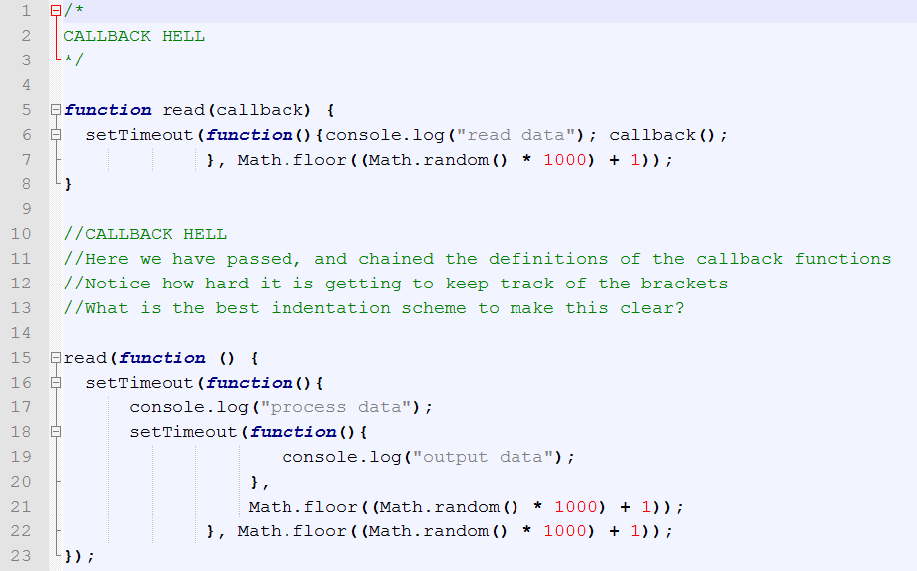
Asynchronous Functions
"Callback Hell"

Slide 19
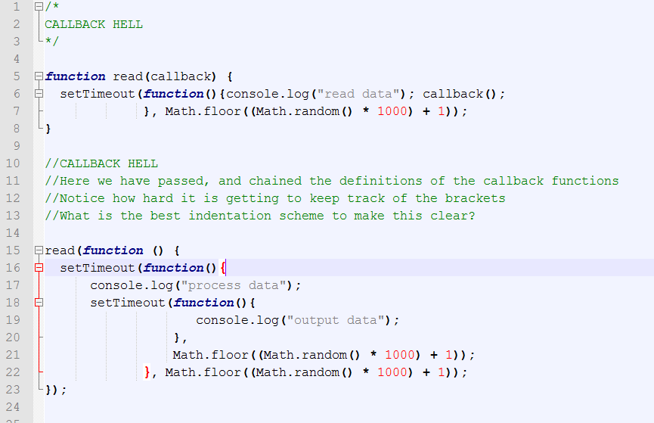
matching brackets
Suggestion: use a editor that allows you to easily see matching brackets (here Notepad++)

Slide 20
Battling Callback Hell
There are several techniques used to battle "Callback Hell".
We will encounter them during the course.
These include:
Event Emitters/Handlers
Middleware and Routing -Express.js
Promises –ES6
Async/Await –ES6
BUT always be able to handle cases that don't use fancy features. That is, be able to deal with "callback hell".

